Slide 1
Machine Learning

Slide 2
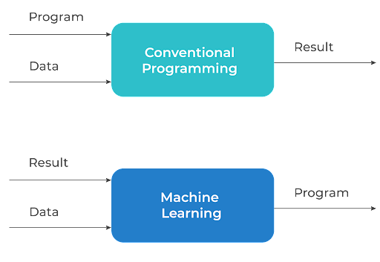

Slide 3
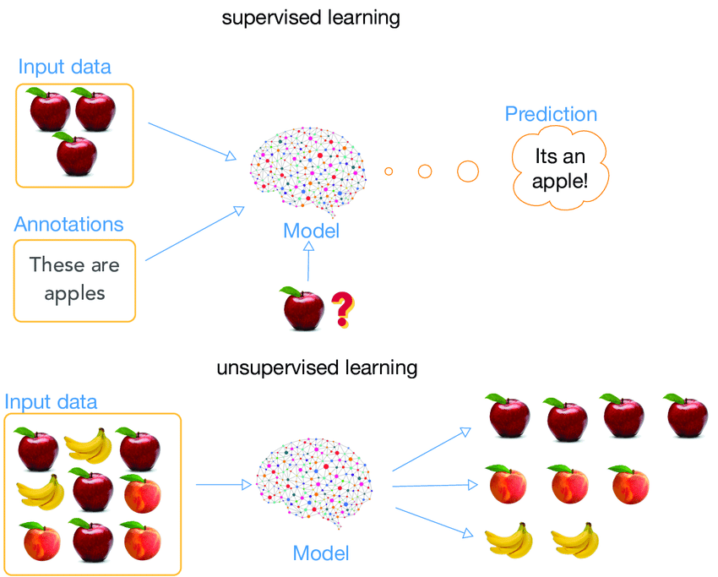
Supervised Learning and Unsupervised Learning

Slide 4
Supervised Learning
Regression
Works on continuous data
Given a value of X determines the Value of Y where Y is dependent on X
Example: House price prediction, sales prediction
Classification
Task of identifying the label or class of the data
Works on the discrete data
Example Dog & Cat classification,

Slide 5
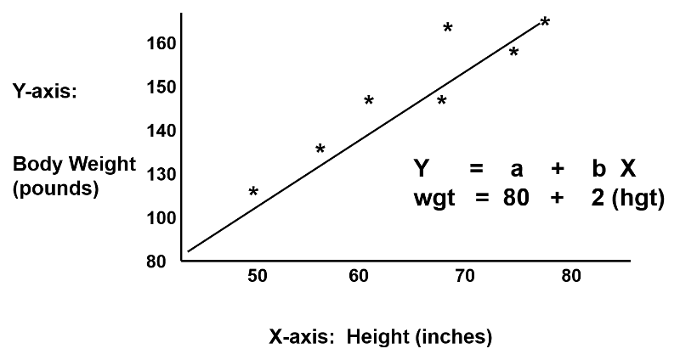
Linear Regression

Slide 6
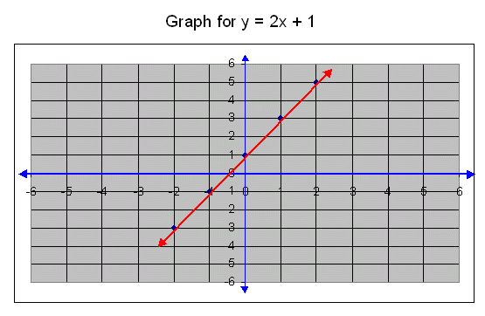
Linear Regression
Y is a continuous data. We have to predict using a function. So what function will best fit the line?
X | 1 | 2 | 3 | 4 | 5 | 6 | 7
Y | 3 | 5 | 7 | 9 | 11 | 13 | ????
Y = 2X+1 (equation of st.line)

Slide 7
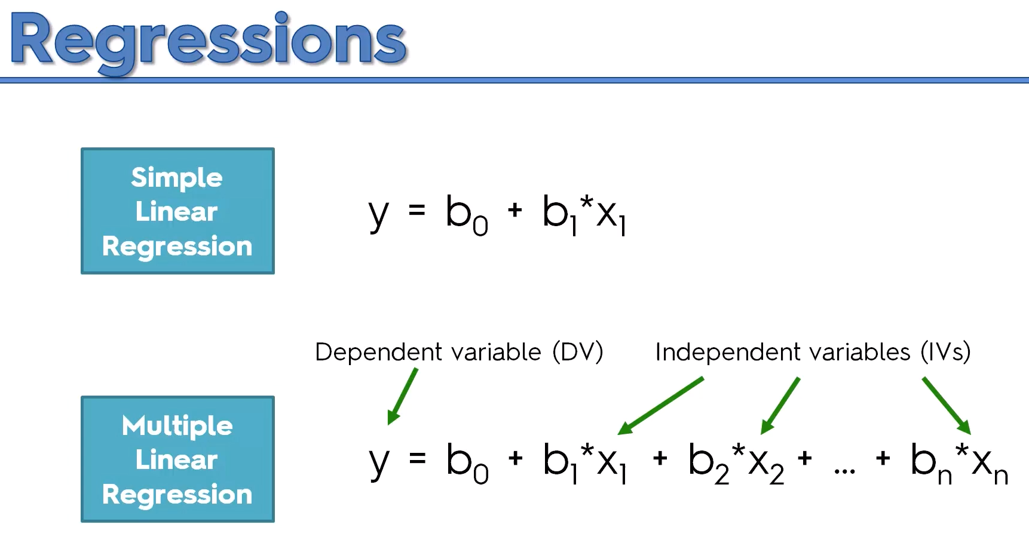

Slide 8
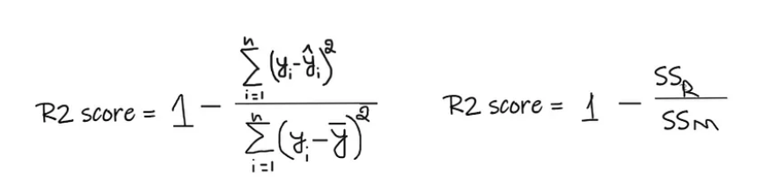
Evaluation Metrics
Regression
R2 score
An R-Squared value shows how well the model predicts the outcome of the dependent variable. R-Squared values range from 0 to 1. An R-Squared value of 0 means that the model explains or predicts 0% of the relationship between the dependent and independent variables.

Slide 9
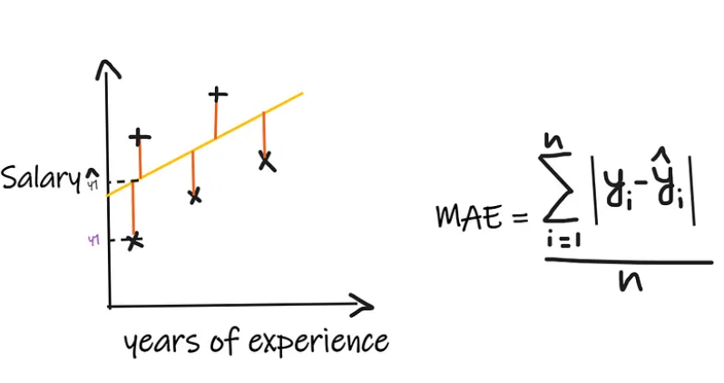
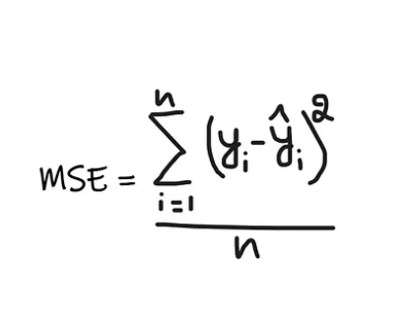
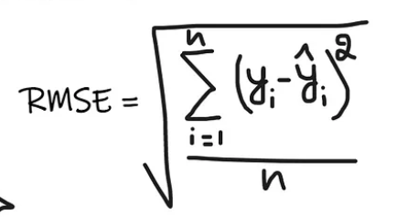
Evaluation Metrics
MAE, MSE, RMSE

Slide 10
Demo

Slide 11
Logistic Regression
Is actually used for classification problem.
For every value of X the hypothesis function Y always lies in between 0 and 1
f(X) = Y=[0,1]

Slide 12
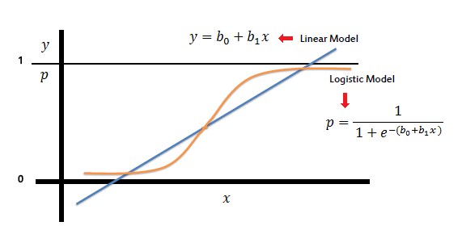
Formula

Slide 13
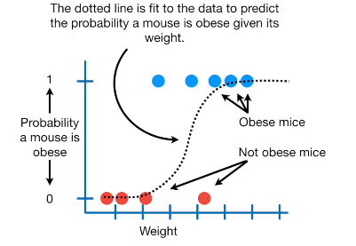
Example

Slide 14

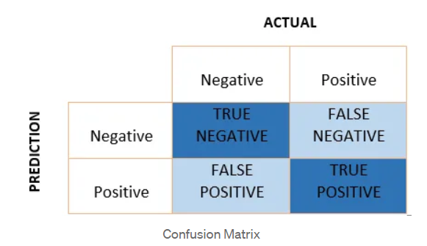
Evaluation Metrics
Classification
Accuracy
Accuracy is one metric for evaluating classification models. Informally, accuracy is the fraction of predictions our model got right.
Confusion Matrix
It is a matrix of size 2×2 for binary classification with actual values on one axis and predicted on another.

Slide 15
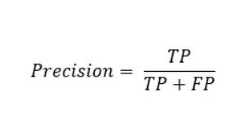
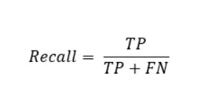
Evaluation Metrics
Classification
Precision
Out of all the positive predicted, what percentage is truly positive.
Recall
Out of the total positive, what percentage are predicted positive. It is the same as TPR (true positive rate).

Slide 16
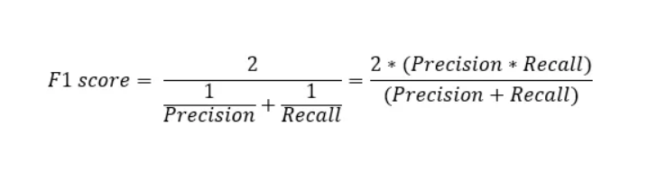
Evaluation Metrics
Classification
F1-Score
It is the harmonic mean of precision and recall. It takes both false positive and false negatives into account. Therefore, it performs well on an imbalanced dataset.

Slide 17
Demo

Slide 18
Different Loss Functions
Mean squared Error(L2 Loss)
Cross Entropy Loss
L1 Loss

Slide 19

Mean squared Error (L2 Loss)
Mean squared error is the most common loss function in machine learning
The formula is :
MSE is the straight line between two points in Euclidian space
In neural network, we apply back propagation algorithm to iteratively minimize the MSE

Slide 20

Cross Entropy Loss
Cross entropy loss is a another common loss function that commonly used in classification or regression problems
Cross entropy is more advanced than mean squared error
the induction of cross entropy comes from maximum likelihood estimation in statistics.
The formula of cross entropy is:
Where y′i is the ground truth label of iith training instance and yi is the prediction result of your classifier for the iith training instance.

Slide 21
Binary Crossentropy
Used when you have a binary classification task
Using BCE loss function,just needs one output node to classify the data into two classes.
The output value should be passed through a sigmoid activation function so the output is in the range of (0–1).

Slide 22
Categorical Crossentropy
Used when you have a multi-class classification task
Using CCE loss function, there must be the same number of output nodes as the classes
The final layer output should be passed through a softmax activation so that each node output a probability value between (0–1).

Slide 23
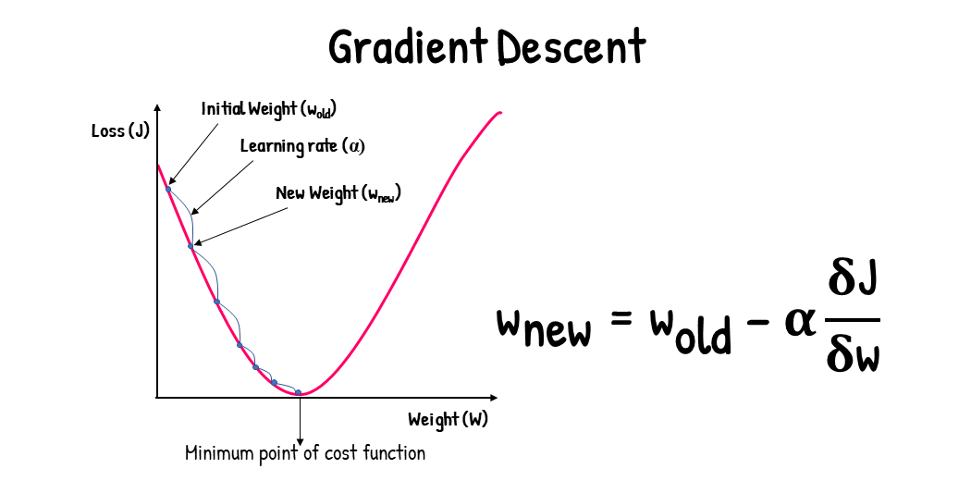
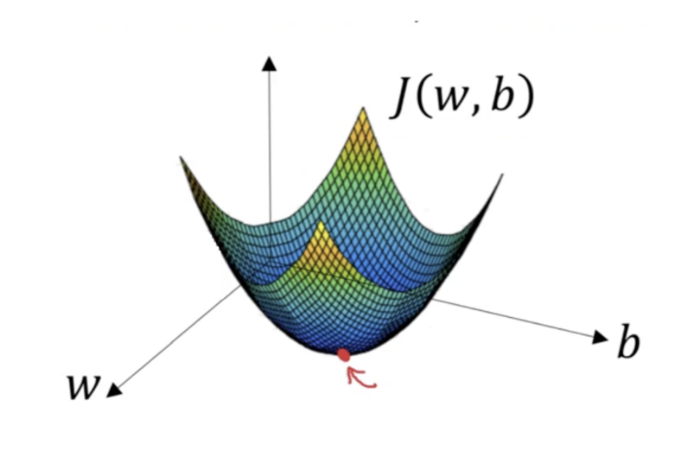
Gradient Descent
Gradient Descent is an optimization algorithm for finding a local minimum of a differentiable function.

Slide 24
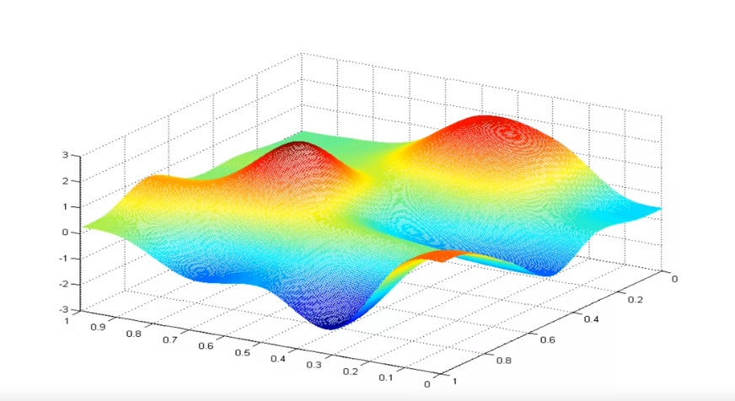
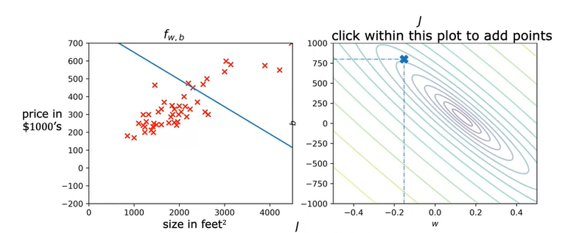
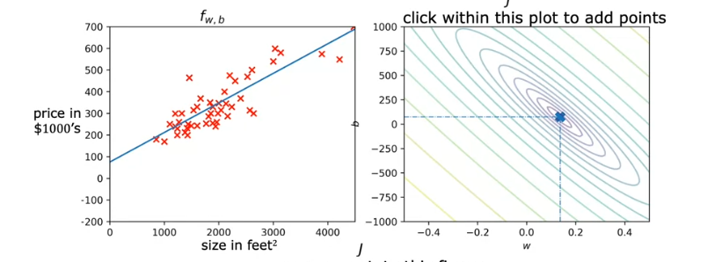
Gradient Descent Visualization
J
W
b

Slide 25
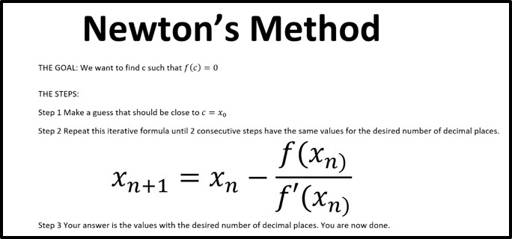
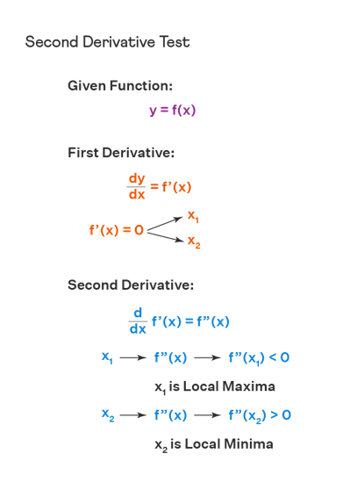
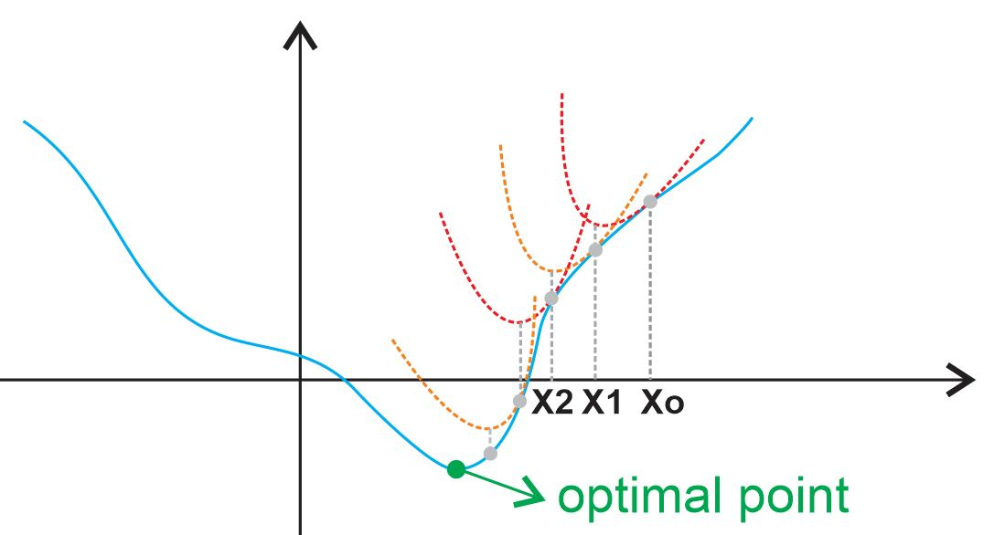

Slide 26
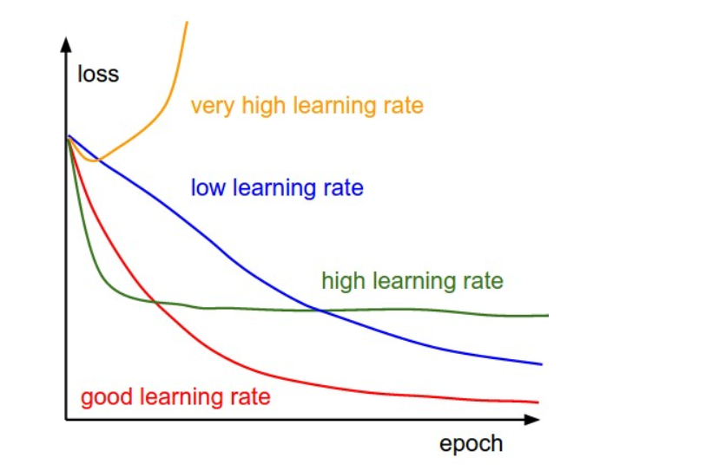
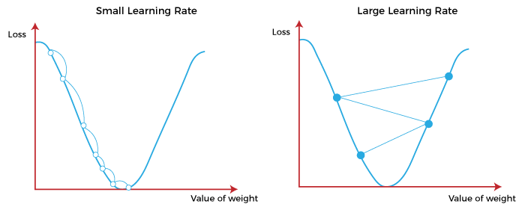
Learning Rate

Slide 27
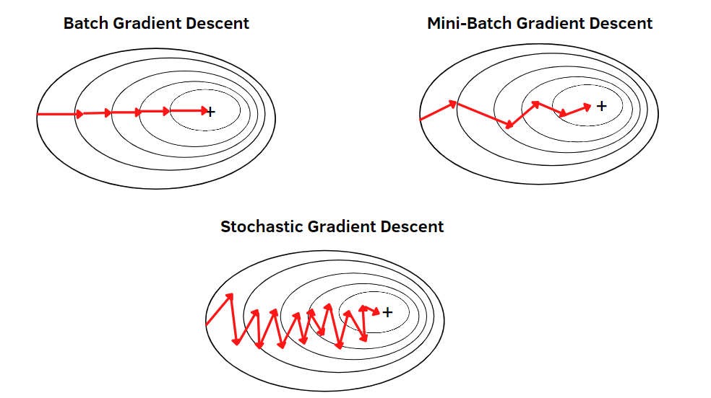
Gradient Descent Types

